Slide 1

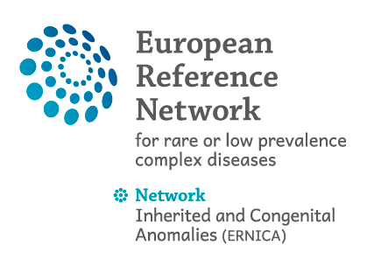
HCD 2023-Quoi de neuf en prenatal?
A.Benachi
Centre Maladie Rare: Hernie de Coupole Diaphragmatique
Centre Pluridisciplinaire de Diagnostic Prénatal - Paris Saclay. France

Slide 2
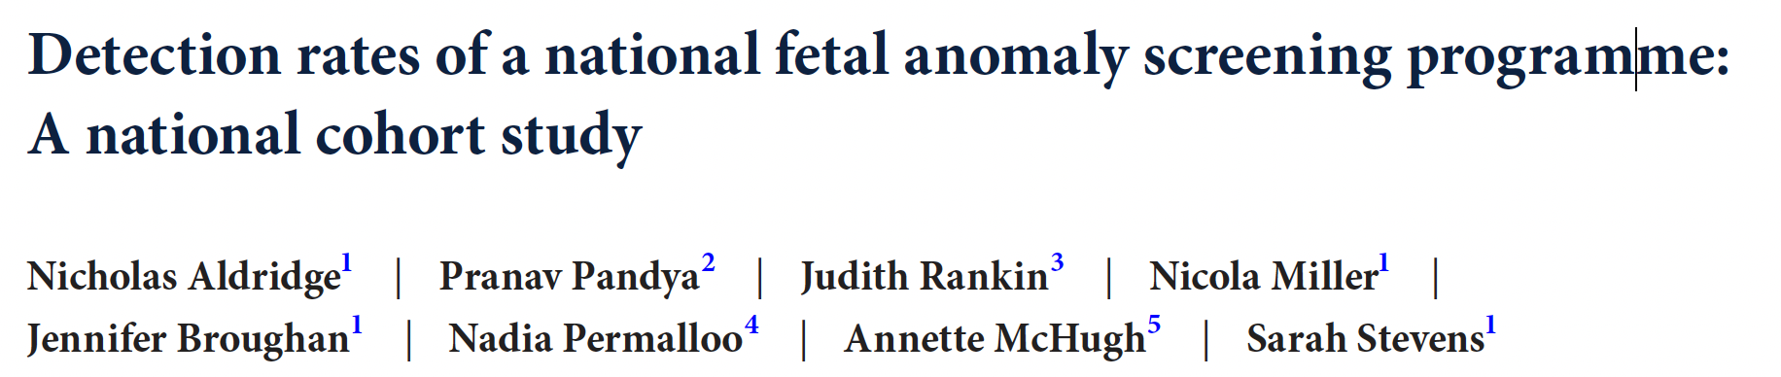

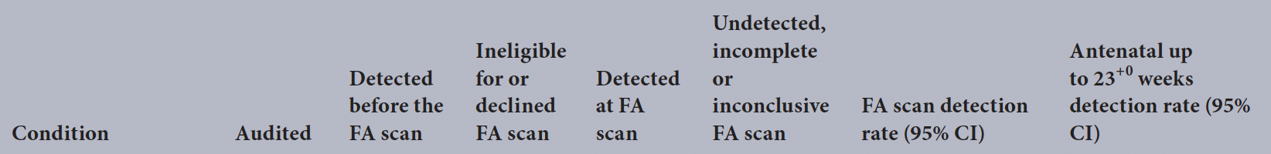
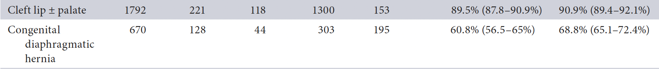

Slide 3
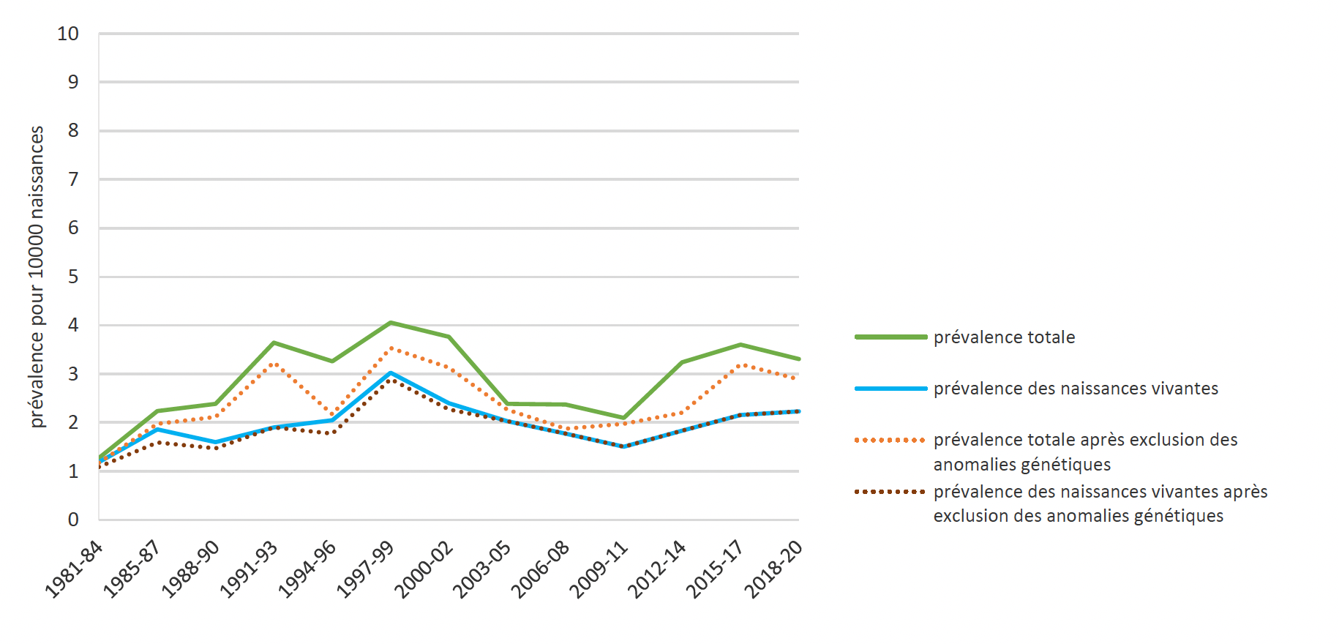
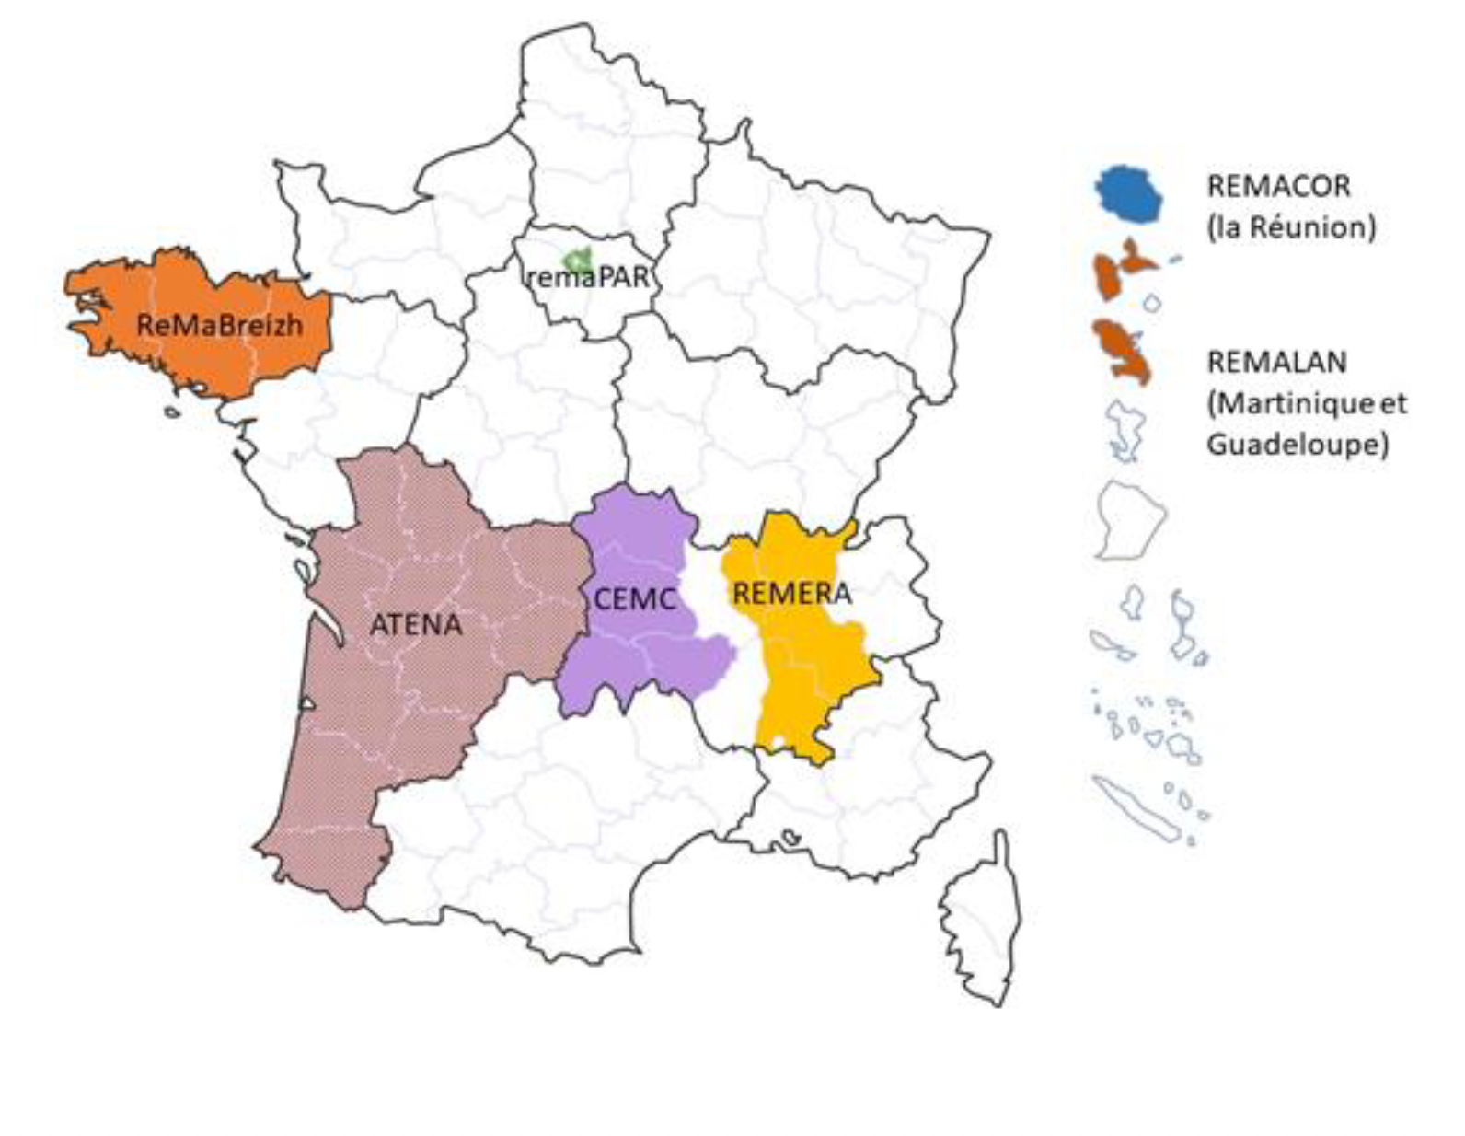
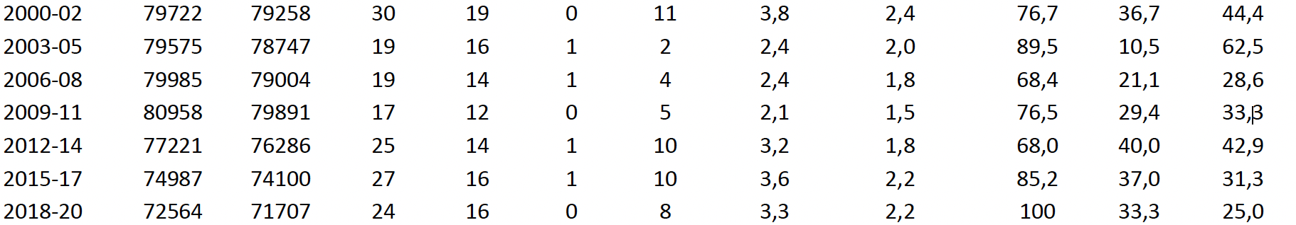
Registre des malformations congénitales de Paris
b: prévalence pour 10.000 naissances. MI: mortalité infantile

Slide 4
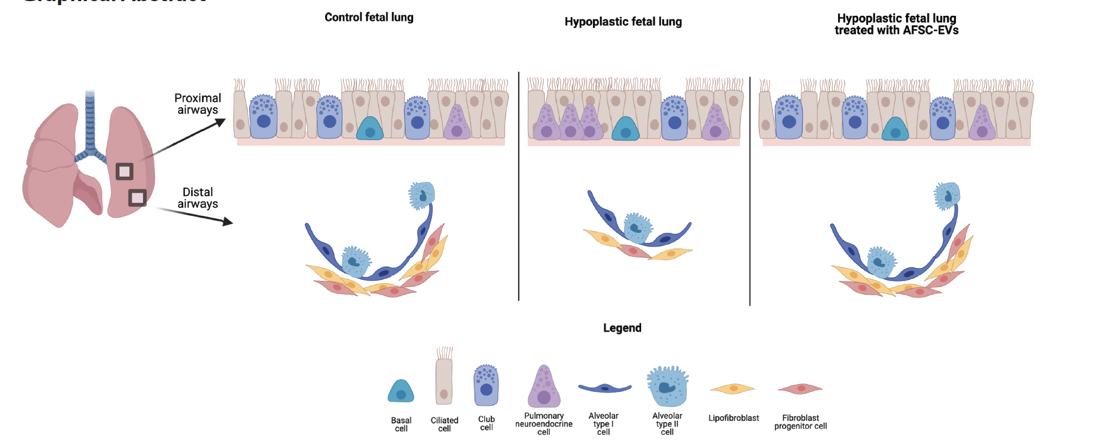
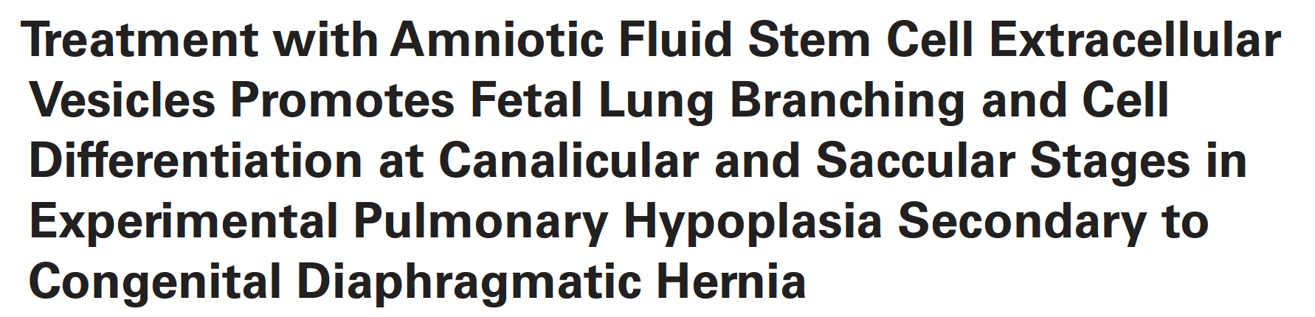
Khalaj K et al.
Amniotic Fluid Stem Cell Extracellular Vesicles (small, lipid-surrounded,cargo-carrying vesicles which can deliver critical information to other cells in an auto, para, or endocrine fashion, influencing cellular change)
Autophagy is a self-degradative housekeeping process wherein abnormal, damaged or pathologic proteins, organelles, or cells are removed or eliminated to maintain physiologic functioning
Key cellular survival mechanism, that has recently been reported to be critical for branching morphogenesis

Slide 5
Analysis pooled data from TOTALs trials
FETO increases risk for premature delivery
For every week earlier insertion,
4 days earlier delivery
-1.7 wks [1.2-2.3]
-3.2 wks [2.3-4.1]
Survival to discharge from NICU | Adjusted OR | 95%- C.I. | P
Late insertion vs.expectant | 1.78 | 1.05 -3.01 | 0.031
Early FETO versus expectant | 2.73 | 1.15 - 6.49
Van Calster B et al. AJOG 2021

Slide 6
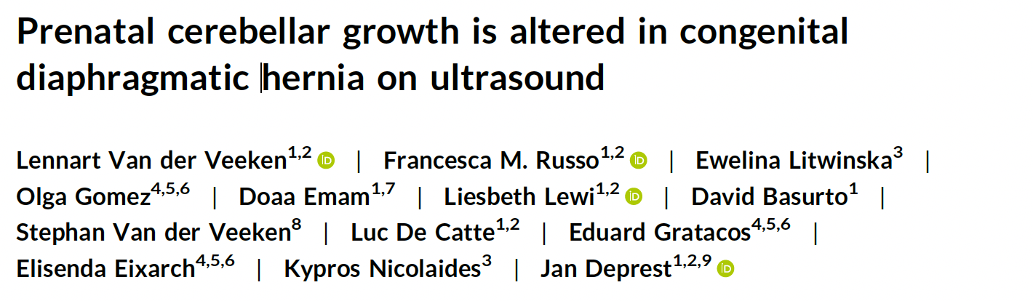

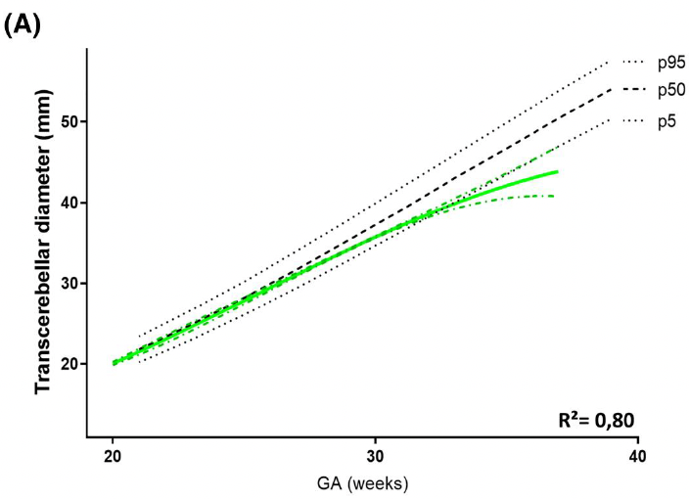
In CDH fetuses, head size was within normal range but the cerebellar diameter trajectory dropped below the fifth percentile after 32 weeks of gestation. The MCA PSV values were consistently lower than in normal fetuses. These observations were correlated with liver
herniation and lung size. Our future studies will focus on brain development and link imaging findings to functional outcomes
It is unlikely that the 10% reduction in MCA PSV would be sufficient to explain the lower cerebellar dimensions

Slide 7
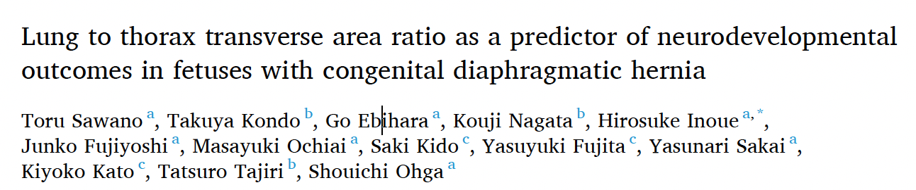
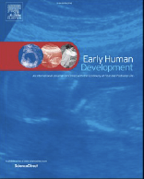

Slide 8
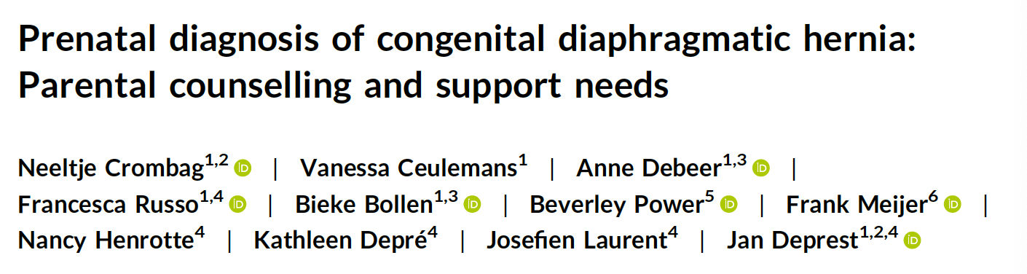
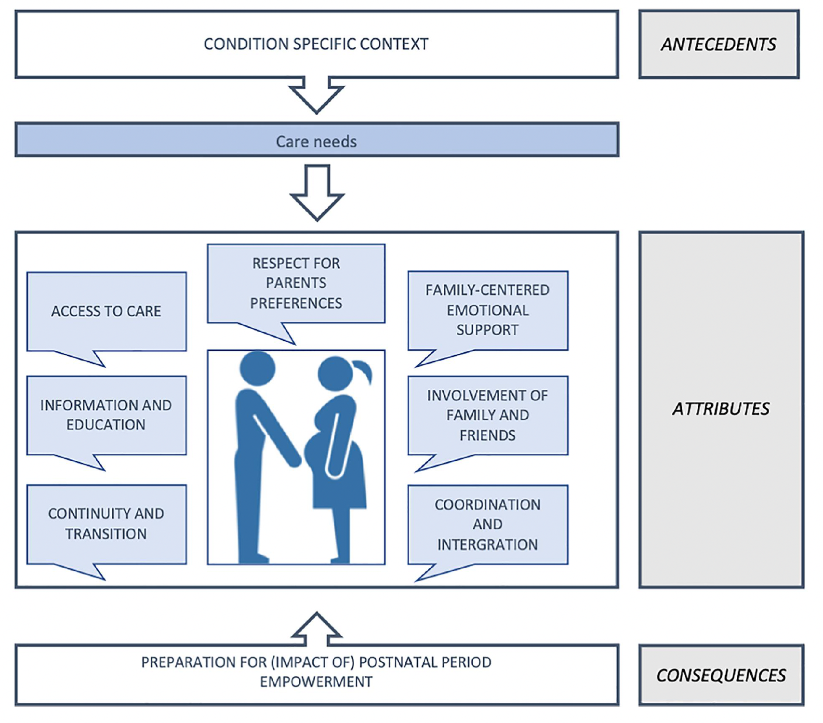
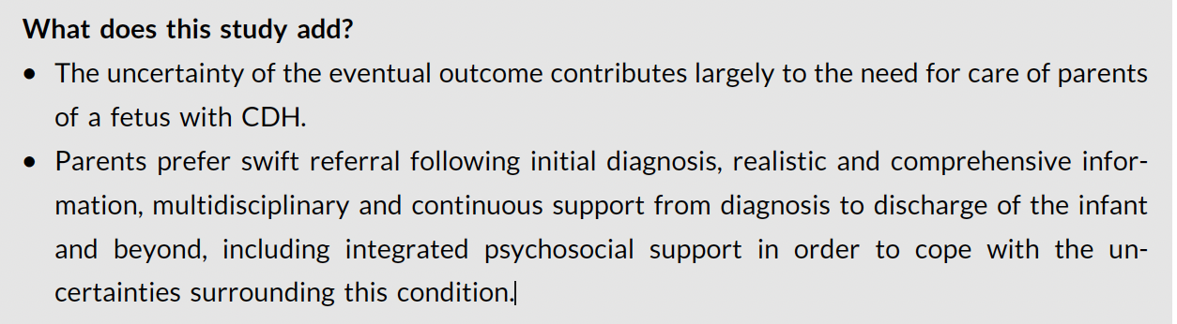

Slide 9
